Slide 1
International Handwritting Analysis
Rui Lu, Neo(Yuyang) Han, Zhishang Bian, Xiangda Li,
Ding Yang, Mohammad Saddam Mashuri, Sage Labios

Slide 2
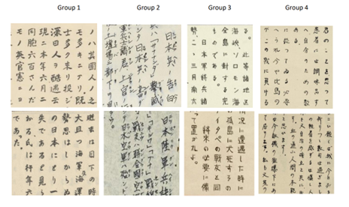
Outline
Introduction
Our project
Team member
Tools
Our Work
Staker Holder Analysis
Current Progress
Risk & Constraints
Milestones
Q&A
(a)：Japanese Handwriting samples

Slide 3
Introduction Our Project:
01
02
03
04
Handing writing analysis tools
CNN
K-mean
Extracting Feacture + Clustering algothrim

Slide 4
Team Members:
Neo Han (Yuyang Han) Spokesperson, Team Leader, Neural Network construction, Image processing
Zhishang Bian Spokesperson, Clustering Algorithm developer
Rui Lu Project Monitor and Neural Network Developer
Yang Ding Clustering Algorithm developer, Testing Engineer
Xiangda Li Image processing Developer
Mohammad Saddam Mashuri Project Monitor, Minute Taker, and Developer
Sage Labios Testing Engineer

Slide 5





Introduction - Tools
Development tools:
Programming language: Python and Java
IDE: Jupyter Lab, VScode, Pycharm
Image Processing: OpenCV + Java
Deep Learning: Pytorch framework

Slide 6




Introduction - Tools
Project Management workplace
Github repo
Discord channels for discussions and announcements
Miro for MindMaps
Google drive for creating shared documents and slides

Slide 7
Stakeholder Analysis
External stakeholders:
Internal stakeholders:
Dr Sophie Constable
Development team,
Shadow team (Wisdom)

Slide 8
Current Progress
Deliverables finished
Statement of Work
Client Map
Environment set up
Roles assignment
Deliverables in progress
Image preprocessing
K-means clustering
Feature extraction (CNN)
Model building and testing

Slide 9
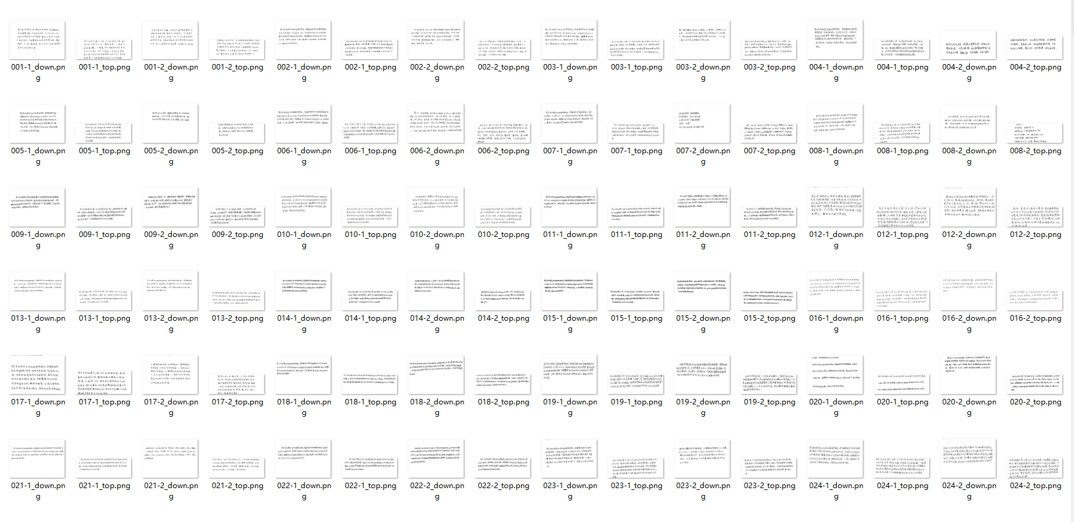
Current Progress

Slide 10
Constraints & Risks
Constraints we found:
The training data doesn’t have ground truth (author).
Japanese writing has triple-script, hard for machine to learn with.
We may be complaint since we are researching the writing of Japanese prisoners of war.
If model is not fitting well, it might affect quantity of analysis.

Slide 11
Milestones
Week
3 | Set up GitHub and start the image preprocess part
4 | Finish picture preprocessing.
5 | Start building our CNN model Start working on the K-mean Clustering
7 | Combine the CNN and K-mean method then test the performance
8 | Introduce new concepts into our model to improve the performance. Implement another clustering method.
11 | Finalize our model and prepare to present it

Slide 12
Thanks!
Do you have any questions?

